Slide 1


Welcome to Cybersecurity
Notes:
Hello my name is…
I would like to show you some of the different types of roles that are available in cybersecurity, that you probably weren’t aware of.
To get started, when you hear the term cybersecurity - what do you first think of? Hackers (attackers)

Slide 2
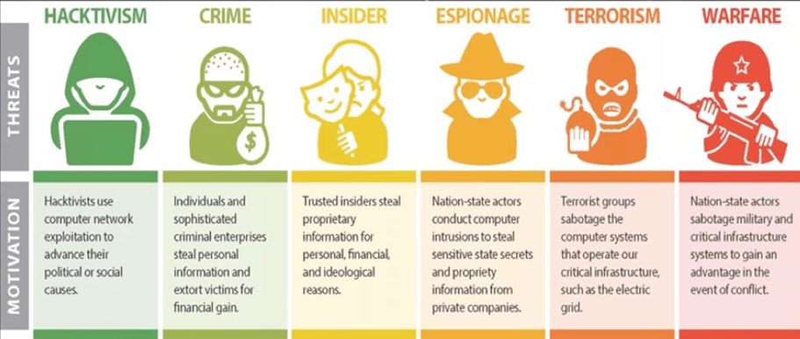
Notes:
Hackers can be divided up into many groups, whether it be financially motivated crime, insider threats, or to gain an advantage during wars.
Today we are going to do an activity where you are going to play different roles, focused around corporate espionage.
To do this, I need to use an example.

Slide 3

The Chocolate Heist
Notes:
And the example we are going to be using is chocolate! Who knows or has seen the movie Willy Wonka and the chocolate factory? If you haven’t I’m setting you homework to go and read the book!
So you all are going to play different roles when it comes to attackng and defending against someone stealing chocolate.
IF you are successful, you get to eat the chocolate!

Slide 4
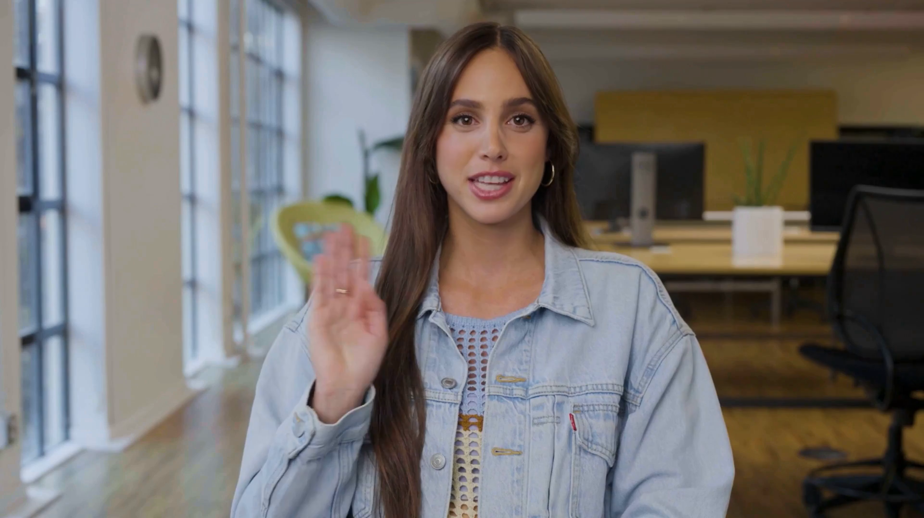

Celebrating the 130th birthday of the Willy Wonka Factory!

Slide 5
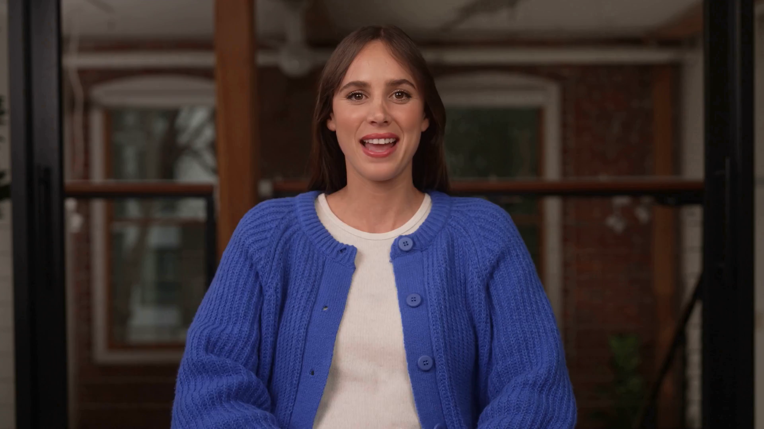

Slide 6
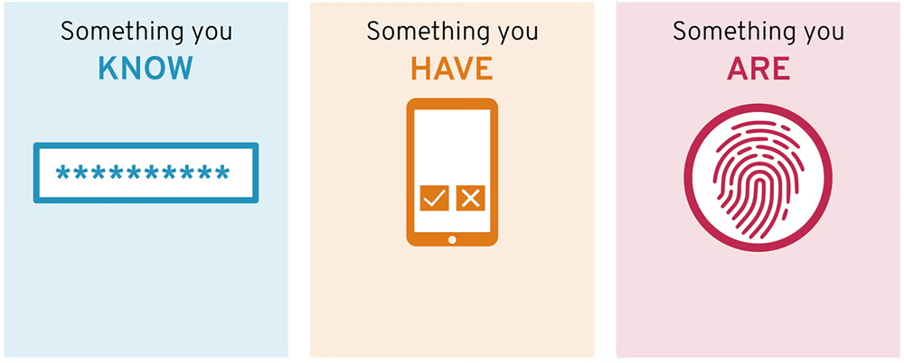
Identify (multi factors)
✓
X
Golden Ticket
Notes:
So first task. You have been engaged to provide some advice to ensure their Golden Ticket campaign goes without a hitch.
This includes ensuring only those with a valid ticket can win the prize, as you have a feeling that some tricky people out there who will pretend to have one of the five lucky Golden Tickets. So you need to find a way to ensure only the lucky winners are the people who they say they are.
How could you do this? Time to discuss in your teams.

Slide 7
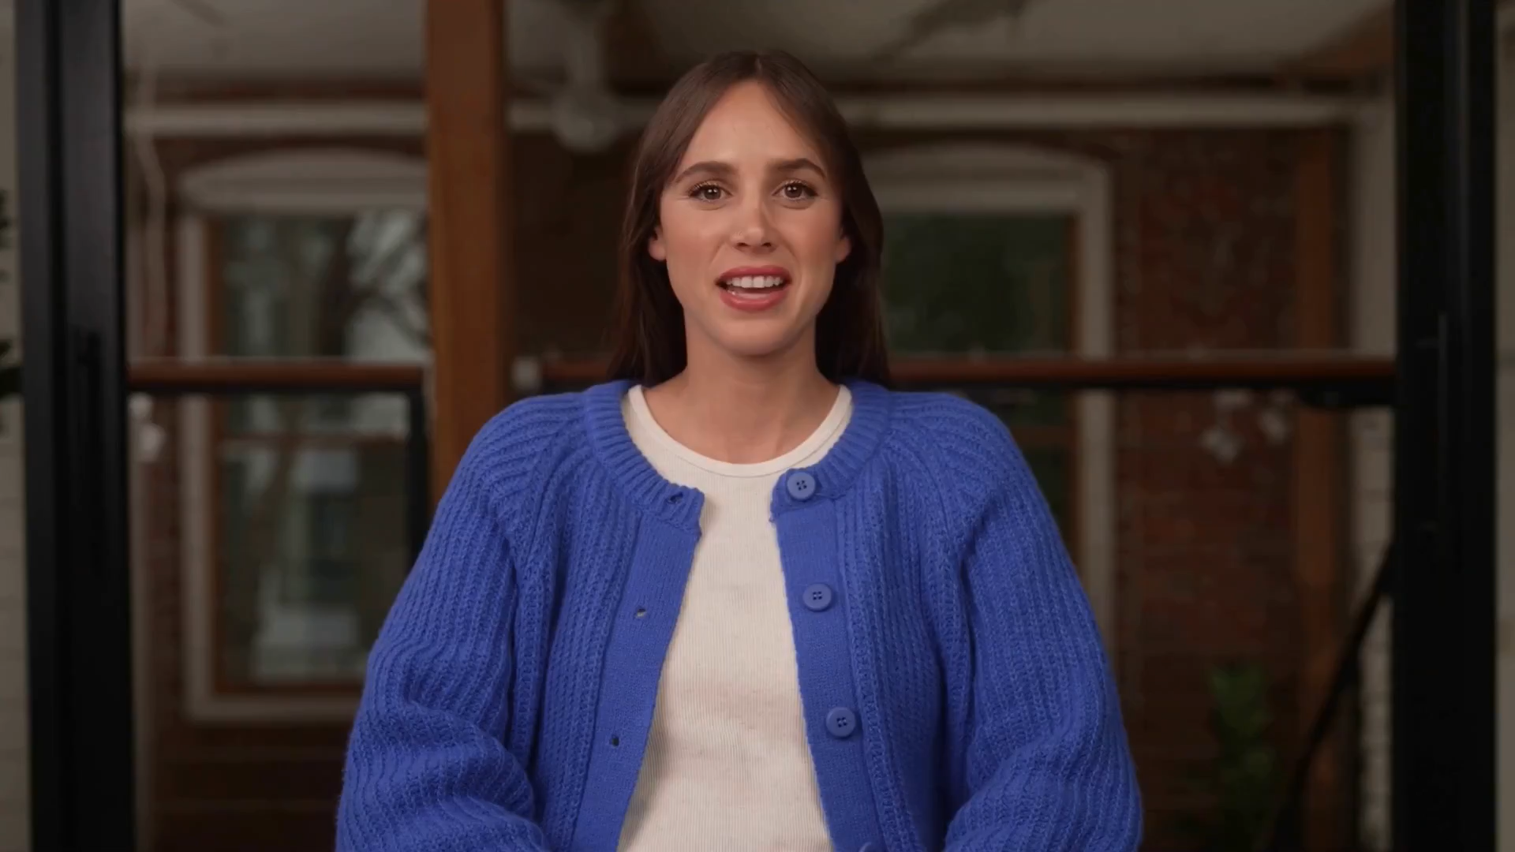

Slide 8
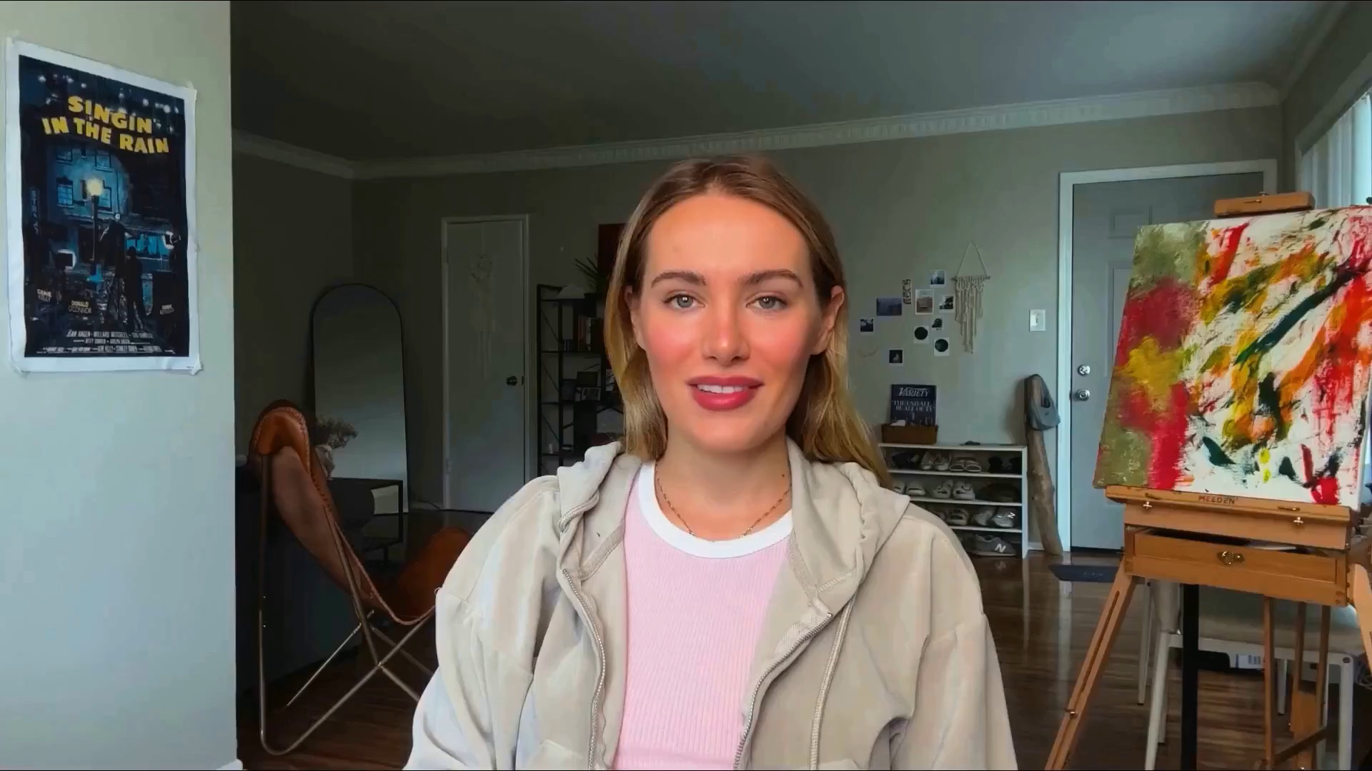

Slide 9

2. Protect (stop or slow)
Notes:
Second task. How you could help stop the or slow the flow attacker traffic to the sites, so the business can continue to operate?

Slide 10


Slide 11
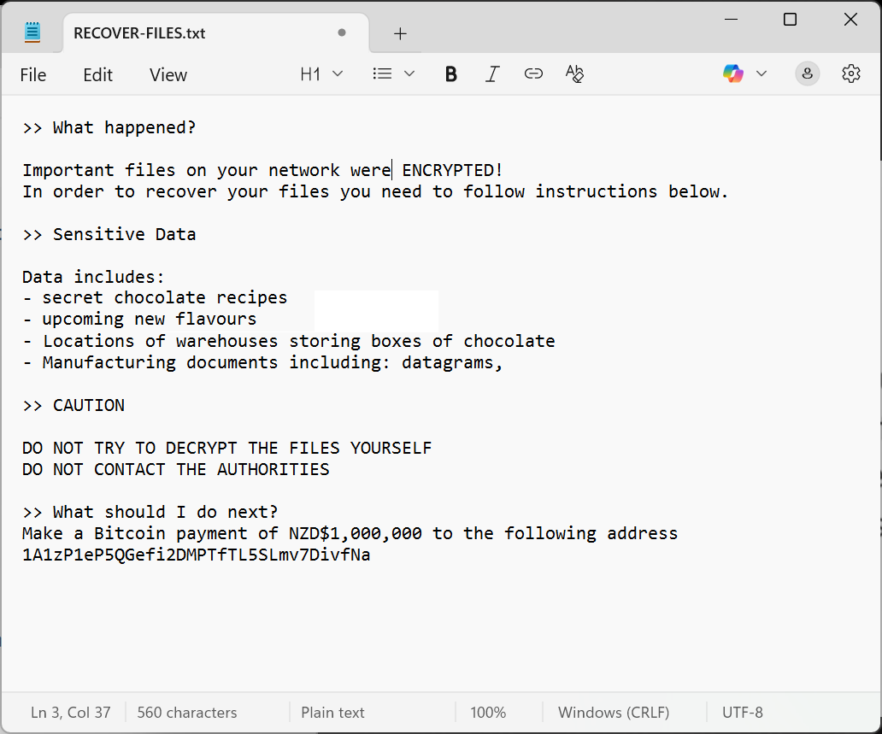
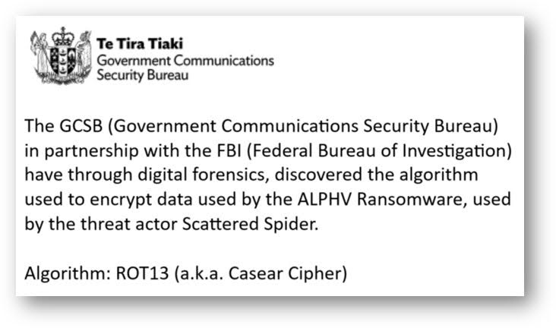
3. Recover (retrieve the key)
Notes:
Third task. Oh no! Everything has been encrypted. Can you use the information to figure out what the decryption key is?
(You’ll need to work across multiple teams to figure it all out)

Slide 12
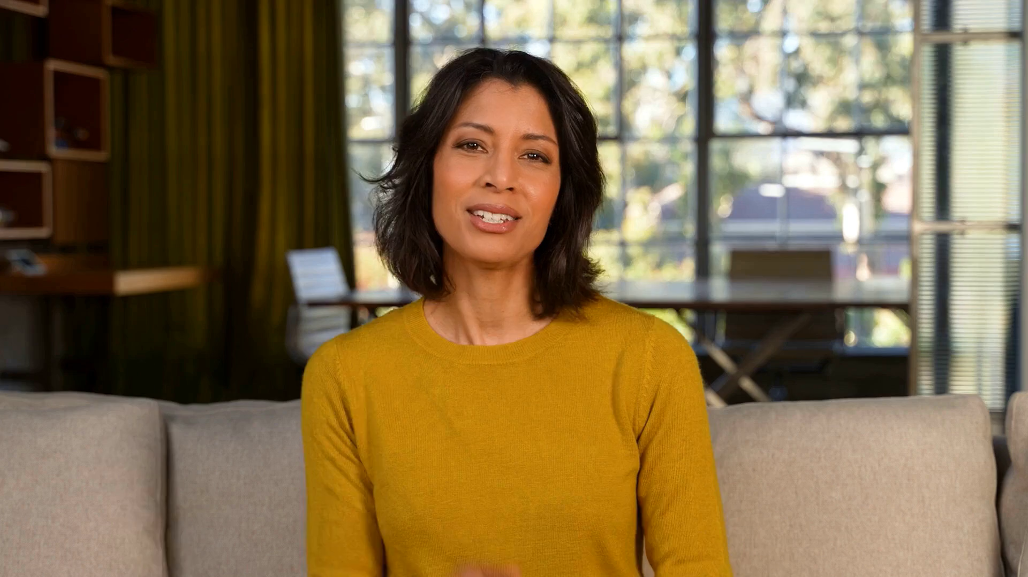
Notes:
You all work for Slugworth Chocolates Inc.!

Slide 13
“We are so grateful to you keeping our business operating and the chocolate flowing, you all get some chocolate!”

Slide 14
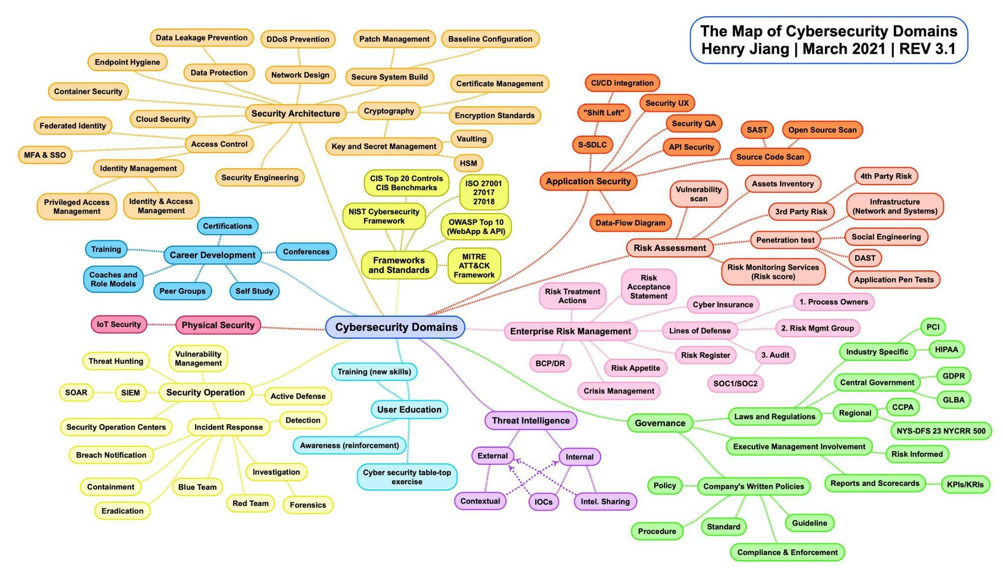






Slide 15
Q&A

Slide 16
Summary
We need more females to join the industry!
Women only make up 20-25% of all positions in cybersecurity.
You don’t have to be technical, but be able to look at things from different perspectives.
There are a wider range of different roles that you can do (and change between).

Slide 17
Thanks!

